Slide 1
Unit 6 Key Points

Slide 2
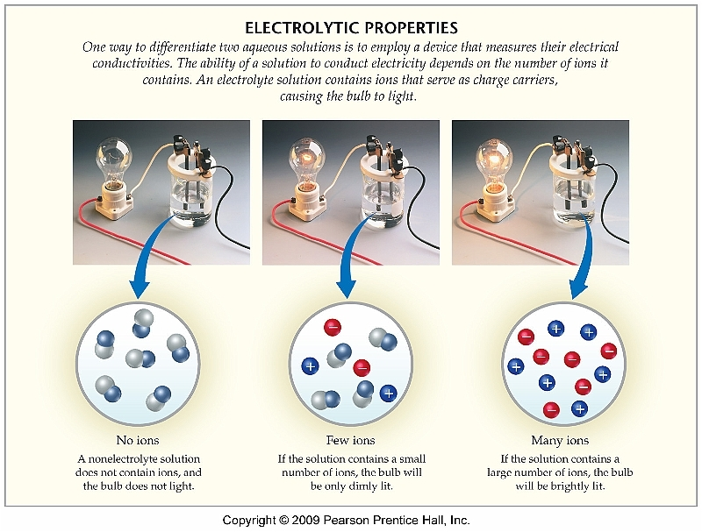
Electrolytic Properties

Slide 3
Acids

Slide 4
Bases

Slide 5
Gas Evolving Reactions

Slide 6
Solubility Rules

Slide 7
Electrolytes
Strong Electrolytes | Weak Electrolytes | Nonelectrolytes
Soluble Ionic Compounds |  | Insoluble Ionic Compounds
Strong Acids | Weak Acids | Covalent compounds that are not acids or bases
Strong Bases | Weak Bases

